Slide 1
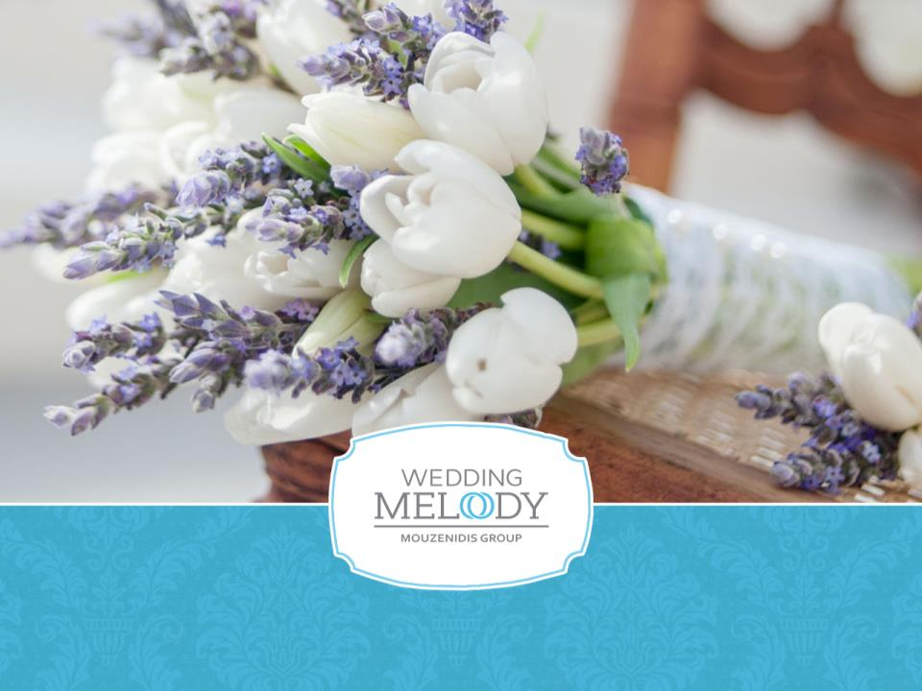

Slide 2
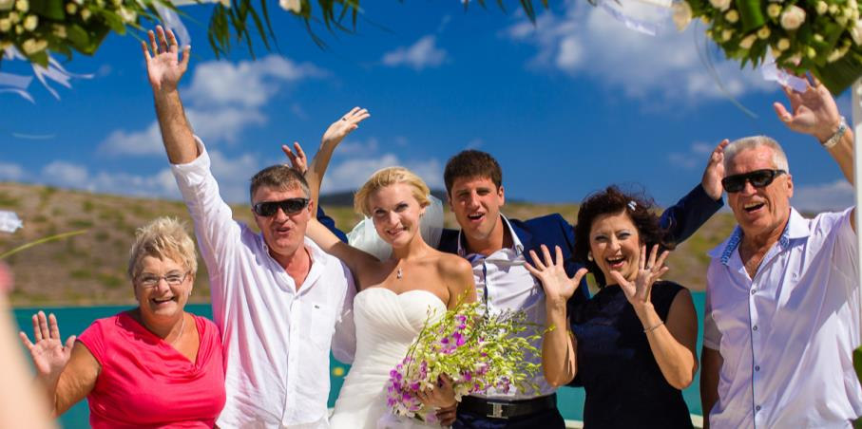
Wedding Melody – We make your dream come true!

Slide 3
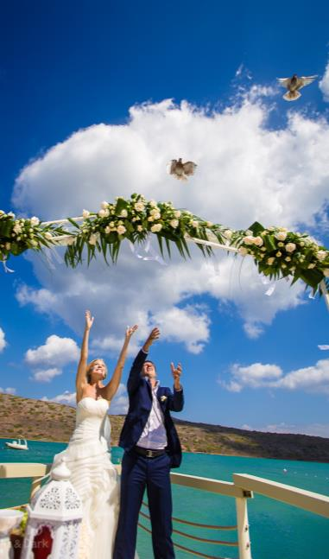
Wedding Melody Mouzenidis Group
Wedding Melody is part of the International Mouzenidis Group that offers unique wedding designs, composes personal dream wedding scenarios and suggests ideas for unforgettable Greek honeymoons & vacations!
Your wedding should be perfect!
Our wedding planners offer different wedding styles - from an antique style or romantic wedding and to a modern or glamorous one. Our wedding experts will make all your dreams and fantasies come true.
We organize ceremonies in the most beautiful destinations of Greece and Cyprus:
Athens, Thessaloniki, Halkidiki, Peloponnese, Rhodes, Crete, Zakynthos, Thassos, Corfu, Santorini, Ayia Napa, Protaras, Paphos, Limassol, Lefcara, Larnaca.
Our company is a bespoke event planner specialized in organizing refined weddings, baptisms, honeymoons and other events through breathtaking design, exceptional planning and flawless execution. We pay careful attention to detail always providing tailor made services in full consistency with the chosen style, the best venues and excellent accommodation.
Our dedicated team creates tailor made ceremonies characterized by creativity, professionalism and aesthetics, and honeymoons that reflect your personality in the perfect atmosphere.
Wedding Melody Mouzenidis Group your own event planner!

Slide 4

Wedding destinations
Halkidiki
Thessaloniki
Pieria
Kastoria
Athens
Peloponnese
Crete
Santorini
Rhodes
Corfu
Thassos
Zakynthos
Paphos
Ayia Napa
Protaras
Larnaca
Lefcaras
Limasol

Slide 5
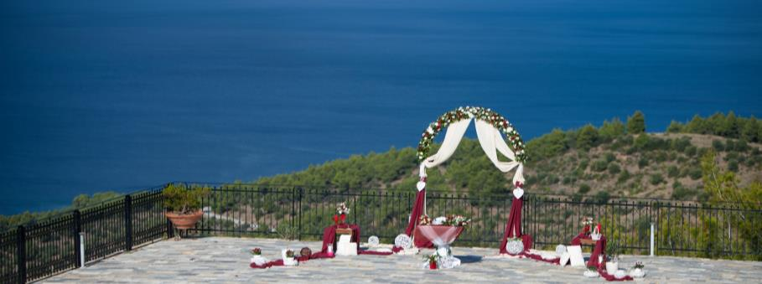
We offer more than 200 venues in Greece for weddings
Parthenon (Potidea Palace Hotel in Halkidiki)
Villa Galini (Halkidiki)
Heliotopos Hotel (Santorini)
Dana Villas Hotel (Santorini)
St George's Chapel in Lindos (Rhodes)
Kallithea Springs (Rhodes)
St Sophia’s Chapel (Rhodes)
Cameo Island (Zakynthos)
Palm Forest (Crete)
Fortezza (Crete)
Palmariva Beach Hotel (Evia)
Le Ciel (Santorini)

Slide 6

Types of ceremonies in Greece & Cyprus
• official marriage
• vow renewal ceremony
• religious ceremony
• project “My Big Fat Greek Wedding”

Slide 7

Symbolic wedding or vow renewal ceremony
It’s the most popular type of wedding, suitable for long married and just married couples, who have married in their home country with a lot of guests and want to experience something special and romantic for two, for couple, who want to bring back wonderful memories and photos of Greece, and for wedding rehearsals.
No documents are required for these types of ceremonies!
Your vow renewal ceremony can take place in the mountains overlooking the sea, on a beach, in a villa, at the hotel, where they stay, at a restaurant, at a terrace, and at other venues suitable for such ceremonies.
A vow renewal ceremony can be held for a couple only or for a couple with guests. The couple can write the vows they want to exchange or simply repeat the words after the emcee.

Slide 8
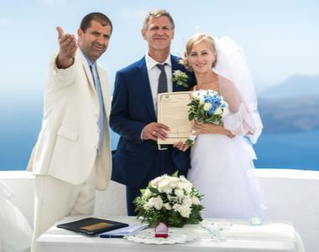
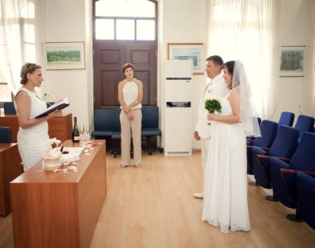
Civil marriage
Greece is a dreamlike destination for your marriage. Civil weddings have been performed legally for the last 30 years.
If you opt for a civil marriage, you should know that in the past, civil weddings in Greece could only be performed at a town hall or other state building. Today, besides the town hall, we can organize your marriage at places beyond your wildest imagination, ideal to have your photos taken! A marriage on a beach, at a hotel, on a hill with breathtaking views or even on a sailing yacht can become real. If you have any special requests about the place where you want to have your marriage, do not hesitate to contact us.
We can make your dream come true!
Even if your marriage cannot be held at this particular location, we can arrange it at a town hall and then organize a symbolic wedding ceremony wherever you wish. Civil weddings are performed by the mayor in his office or by someone authorized by the mayor. The ceremony lasts 15 minutes. The mayor proclaims you husband and wife and delivers a wedding certificate to you.

Slide 9
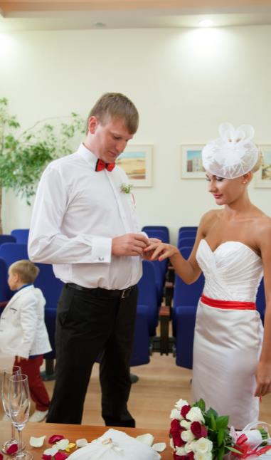
Civil wedding
List of documents needed for a civil marriage:
Full birth certificates for both parties
The couple is obligated to obtain full version birth certificates containing the parents’ details.
Certificate of Non-impediment to marriage for both parties
This document confirms that you are free to marry. This document is available at your local Registrar and it shouldn’t be issued more than 3 or 6 months (depending on your country) before your wedding day.
Please note that 2 certificates are required: one for each party
Decree Absolute
In case of one or both parties having been divorced, you are obligated to obtain a decree absolute
Spouse's death certificate and previous marriage certificate
If you are widowed you are obligated to obtain this certificate.
Deed Poll or Statutory Declaration
You need this document if you changed your name in the past. Please note this includes divorcees who have reverted to their maiden name.
Adoption Certificate
In case of one or both parties having been adopted, you are obligated to obtain this certificate.
All documents should have an Apostille Stamp as proof of their authenticity. The “Haager Apostille” certifies the copy as a legal document.
In addition to the above documents, you need the following without an Apostille Stamp:
Passport or ID copy for both parties

Slide 10
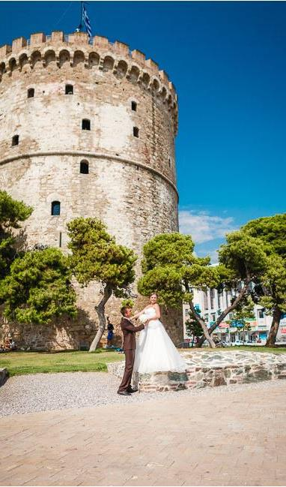
Civil wedding package
Wedding Package:
Booking of your wedding date and time
Registrar’s fees for your wedding ceremony
Checking of papers with local authorities
Administration & handling fees
Translation of the standard list of documents required for your wedding
Pre-wedding meeting with your wedding coordinator (in your hotel)
Personal wedding coordinator throughout your wedding ceremony
The official ceremony at a city hall
Master of ceremonies
Provision of 2 witnesses (if necessary)
Bridal bouquet & groom’s button-hole (seasonal flowers, color of your choice)
Ring pillow
1 bottle of sparkling wine
Wedding gift from our company
Price starts from 1184 €

Slide 11
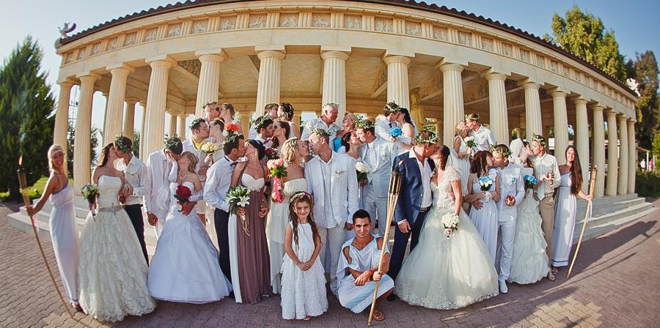
“My big fat Greek Wedding”

Slide 12
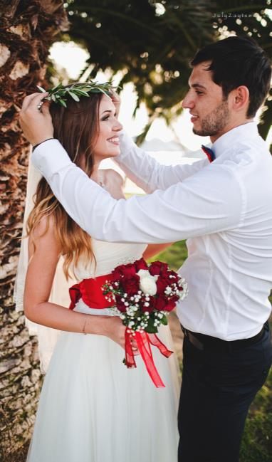
“My big fat Greek Wedding”
We organize our signature project “My Big Fat Greek Wedding” on annual basis, ideal for those who want to celebrate their vow renewal, wedding anniversary or just want to experience a not-at-all-legally binding authentic Greek style wedding ceremony together with other couples!
Wedding package:
Reservation of a wedding venue
Champaign for the couple
Bridal bouquet & groom’s button-hole (seasonal flowers, color of your choice)
White pigeons
Romantic dinner for the couple
Wedding cake (for each couple)
Live music band at dinner
Entertainment program
Professional photographer (2 hour photo shoot)
Videographer
Fireworks
Price: 670 € per couple
*The offer is valid for a group minimum 10 couples

Slide 13
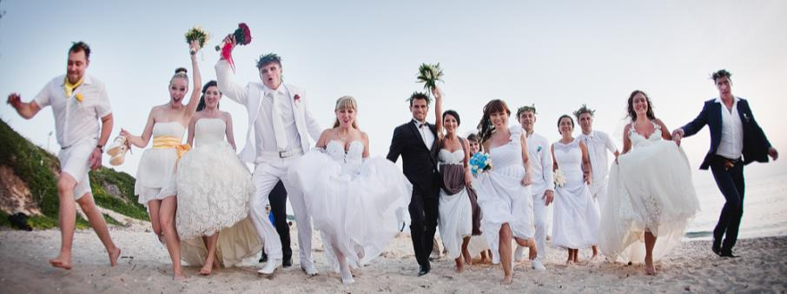
We provide the following services:
Wedding banquet or dinner
Live music, master of ceremonies, DJ, show
Rentals of wedding dresses and suits
Photography and videography
Stylist and makeup artist
Romantic cruise on yacht
Amazing decoration
Unique scenario
Bachelorette party and stag party
Honeymoon
Accommodation in 2-5* hotels
For your transportation we offer
Cars
Retro cars
Mini vans
Buses
Donkey or horse rides
Yachts
Helicopters

Slide 14
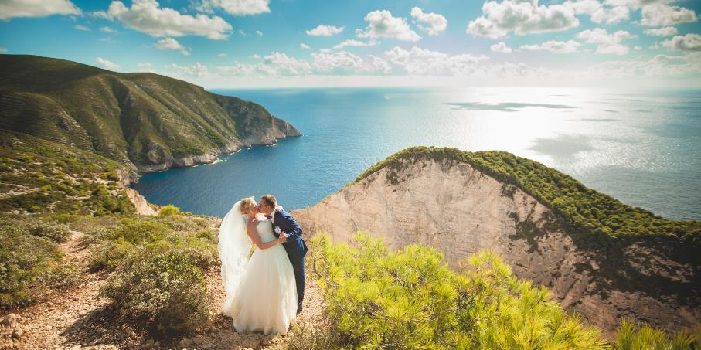
Our weddings

Slide 15
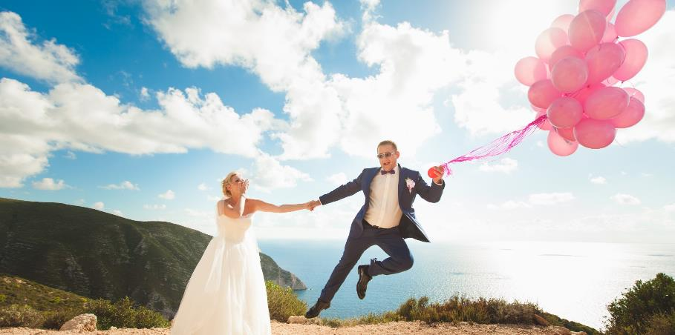
Our weddings

Slide 16
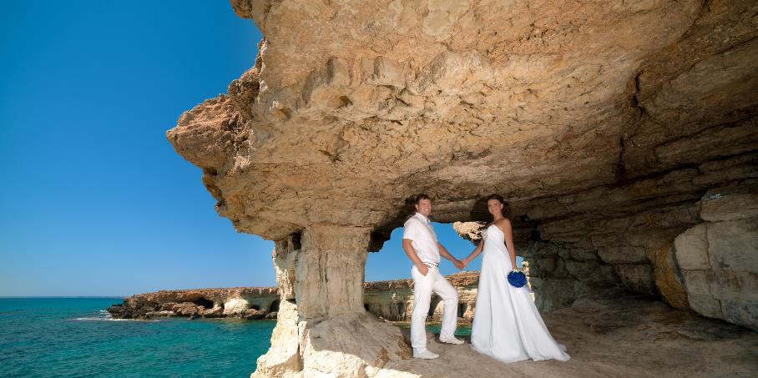
Our weddings

Slide 17
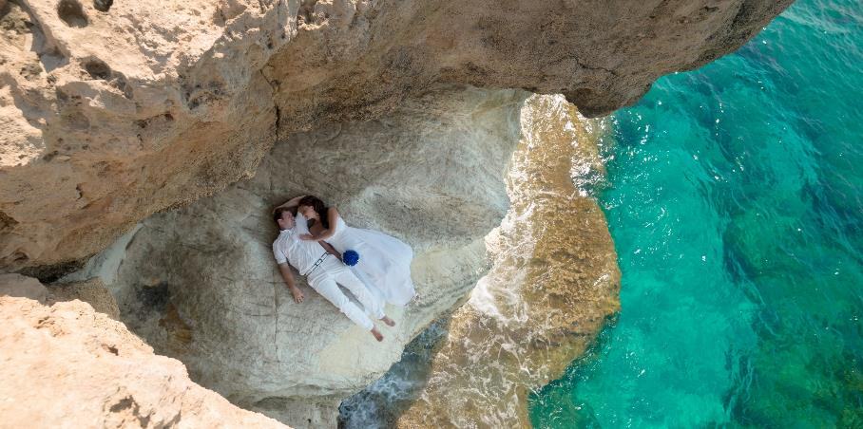
Our weddings

Slide 18
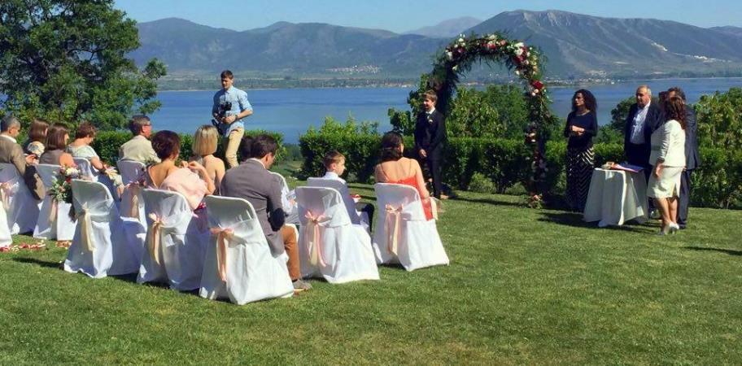
Our weddings

Slide 19
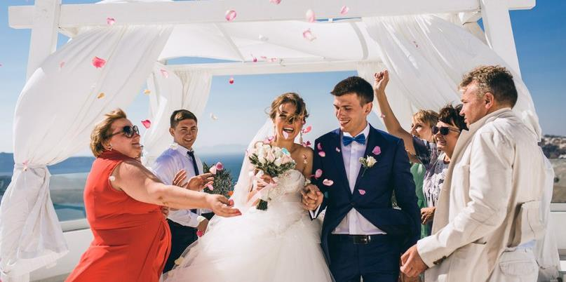
Our weddings

Slide 20
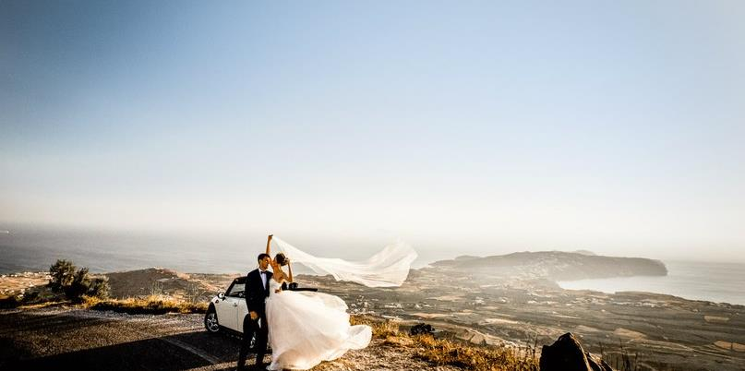
Our weddings

Slide 21

Our weddings

Slide 22

Our weddings

Slide 23
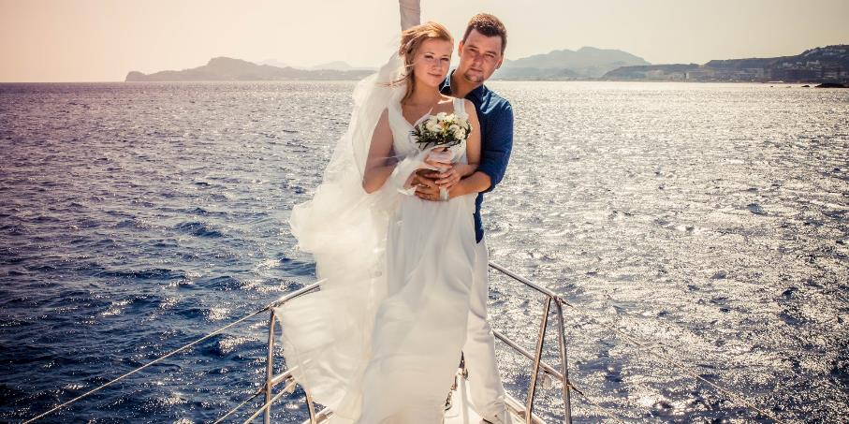
Our weddings

Slide 24

Our weddings

Slide 25
For reservations and counseling:
Tsakalidou Sofia
E-mail: wedding@mouzenidis.gr
Tel.: +30 (2310) 591.531
Mob.: +30 6979722090
http://wedding.mouzenidis-travel.com/

