Slide 1
GALLIPOLI ANZAC DAY DAWN SERVICE
25 APRIL 2016

Slide 2
Overview
The Australian and New Zealand Governments are committed to continuing the Gallipoli Anzac Day Dawn Service.
As in previous years the Dawn Service will be held at the Anzac Commemorative Site at 5:30am on 25 April 2016.
The ballot for attendance was for the 100th anniversary commemorations only. In 2016 the Anzac Day commemorations will be open to all those who wish to attend within the safe capacity of the site and who comply with the security and entry requirements.
There is no ballot to attend the commemorations in 2016.
We encourage registration of visitors via the DVA website.

Slide 3
Changes in 2016
While the Dawn Service will continue, the most significant change to the arrangements for the 2016 commemorations will be that the Australian Service which is usually held at Lone Pine around 11am on 25 April will not be held, however there will be a service at Lone Pine on the 6th August 2016.
The Chunuk Bair service on 25 April will be conducted from 1130. Please visit http://ww100.govt.nz/anzac-day-2016-gallipoli for further information on the NZ service.
As a result of the Lone Pine service no longer being held departing visitors will either load on their coaches at the conclusion of the Dawn Service at Anzac Commemorative Site rather than on Second Ridge as has occurred previously or, if attending the New Zealand service or other sites on Second Ridge will walk to these services and be picked up at Chunuk Bair or these other sites. If visitors are attending sites on Second Ridge they will need to make arrangements with their tour operator as to where they will be picked up from.
Akbas cemetery will not be utilised in 2016 and there will be no ticket scanning processes. Coach registration will take place at Mimoza Park Otopark as in 2014 and previous years.
Coach registration will not commence until 11am on 24 April. Mimoza and ACS will be closed to arrivals prior to this point.
Early arriving visitors prior to site opening (1800, 24 April) will disembark at Mimoza Park Carpark and proceed into Mimoza Park for transfer to ACS just prior to site opening. Following site opening coaches will be registered at Mimoza Park Carpark and then proceed to Beach Cemetery to disembark visitors.
There will be no pre-registration of Assisted Mobility visitors, and there will only be a very small capacity for movement of assisted mobility between ACS and Chunuk Bair after the Dawn Service. Any visitors requiring transport between Mimoza or Beach Cemetery to ACS can request to use one of the shuttles at these sites after they arrive. Any assisted mobility visitor with a genuine need to use the assisted mobility amenities can apply at the ACS information tent for a pass to sit in the assisted mobility seating area.
Reduced seating infrastructure at ACS will result in a slightly lower site capacity of 5,900. If capacity is reached, further entries to ACS will be prohibited and any visitors arriving after this point will be directed to Mimoza to view the service on a large screen at that location.

Slide 4
Ministers Wreath laying Lone Pine – 24th April
Minister Veterans’ Affairs Australia will conduct a private wreath laying activity at approximately 1500 on the 24th April.
This wreath laying is open for attendance by the public
As a result of other services on Second Ridge road the Jandarma will close access to 2nd Ridge Road between 1400-1700 on the 24th April.
Visitors and Tour operator buses must register at Mimoza prior to attending Lone Pine.
Visitors attending the Lone Pine Service can choose to return to Mimoza on their tour bus after 1700 or walk down Artillery Road to Southern Entry.

Slide 5
Lone Pine Service – 6 August
A service will be held at Lone Pine on 6 August 2016.
Details for this service are currently being developed and will be announced once arrangements are confirmed.

Slide 6
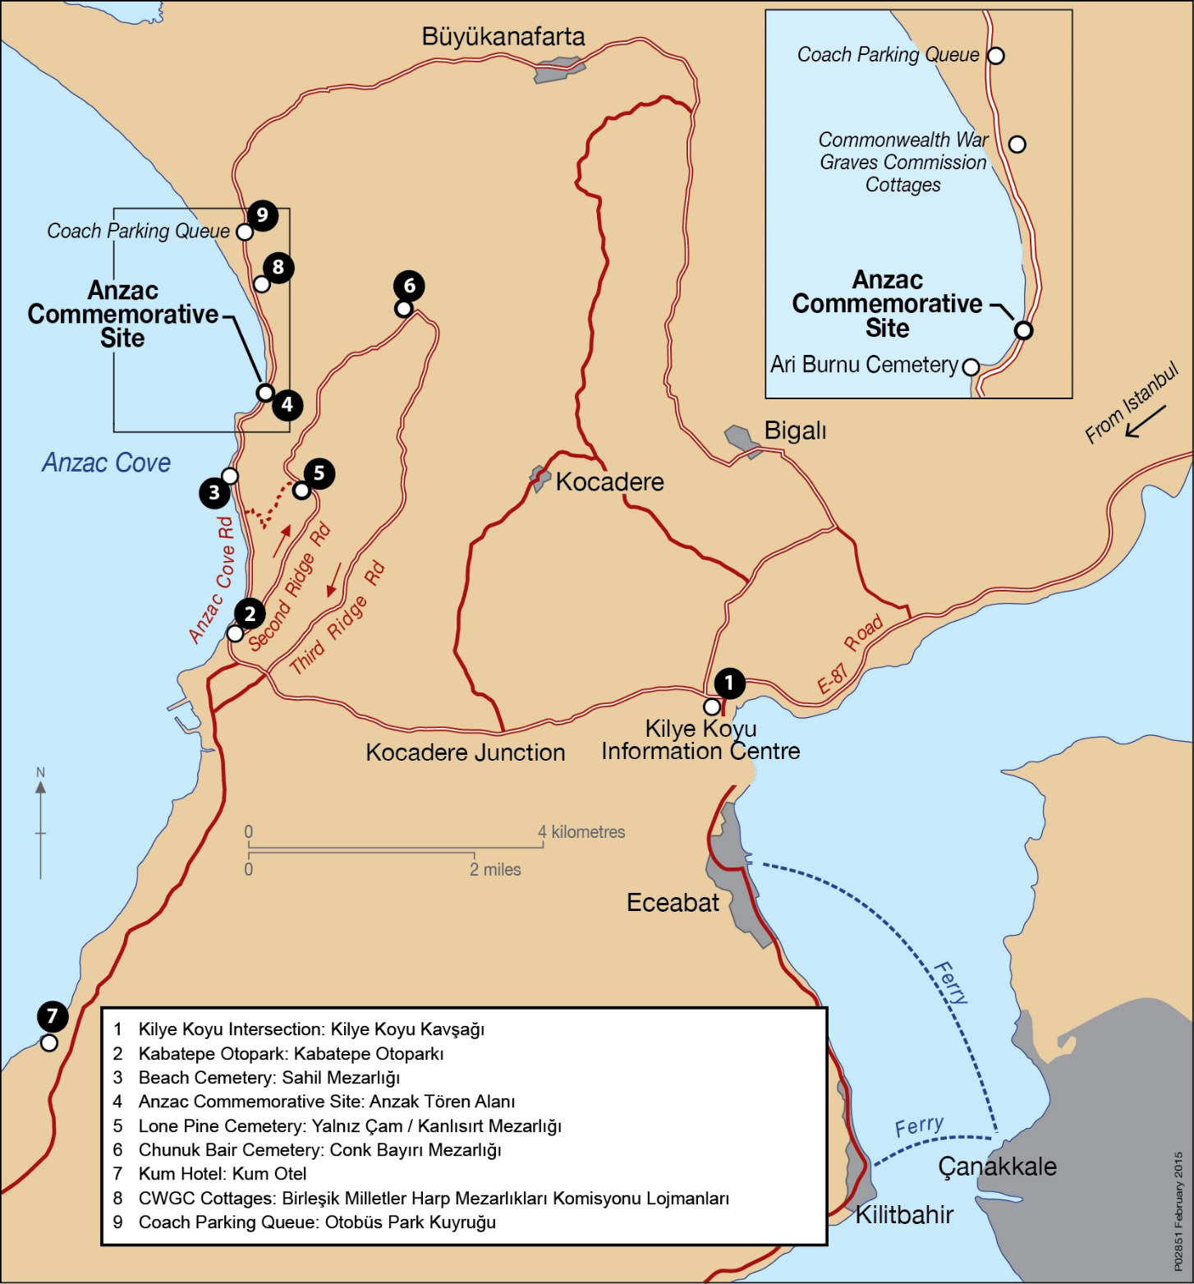
Visitors Arrival
Mimoza Park Carpark opens for registration at 11am on 24 April. No early arrivals will be permitted.
The northern entry will be closed to visitor arrivals. All visitors must arrive from the South of ACS and coaches must register at Mimoza Park Carpark.
Prior to 1600, visitors will disembark at Mimoza Park Carpark and proceed across the road to Mimoza Park where they will await the opening of the site.
Just prior to site opening, visitors will be able to depart Mimoza to travel to the site. From Mimoza visitors can either walk into ACS or catch a shuttle bus available for visitors requiring assistance.
While visitors are transiting on foot from Mimoza to ACS there will be a temporary road closure prohibiting further arrivals into Mimoza Park Carpark until the road is clear in order to allow safe pedestrian movements. This is expected to take place between 1600 and 1830, but could vary depending on whether Mimoza reaches its capacity before this time.
After the visitors have cleared from Mimoza, from approx. 1830 coach registration will recommence at Mimoza Park carpark. From this point after the coaches have been registered and visitor messages delivered at Mimoza Park Carpark, the coaches will then proceed to Beach Cemetery to disembark their visitors.
After dropping off their visitors (either at Mimoza or at Beach Cemetery depending on the time of arrival) coaches are to depart the area and travel via Bigali and Buyukanafarta to the holding point north of the Commonwealth War Graves Commission cottages.
Anzac Cove Road will be closed to further arrivals at 0300 on 25 April. No late arrivals will be permitted after this point.
It is far better for visitors to arrive with coach tours rather than self drive – this enables shelter and quick evacuation in an emergency and will simplify departures after the services. There is no visitor parking close to the Anzac Commemorative Site.
After VIPs have departed following the Dawn Service visitors will be collected from Anzac Commemorative site by their coaches and then continue on with their tours. Anzac Cove Road will be a one-way, north to south thoroughfare while visitors are being collected from ACS. Coaches will therefore need to be in the coach queue north of ACS to be able to proceed to ACS to load their visitors.

Slide 7
Coach loading at ACS
Coaches will queue north of the Anzac Commemorative Site after dropping off passengers.
Departing visitors will board their coach at Anzac Commemorative Site after the Dawn Service.
After VIPs depart after the Dawn Service, coaches will be brought forward in groups of 5 from the holding point to the centre of ACS where a number of coach loading zones will be set up. Coaches should ensure they stop on the left hand side of the road to facilitate loading from the roadway.
Visitors will be advised of coaches arriving via the big screens and the loudspeaker system. There will be three separate announcements “Get Ready”, “Next to Board” and “Now Boarding”.
Once loaded, coaches will depart ACS to the south past Mimoza and be able to continue with their tours.
Any coach which delays the departure process (eg. through missing passengers or other cause) will be directed to Beach Cemetery to await the missing passenger when their group of 5 coaches departs. Tour providers are encouraged to ensure their visitors are all together when the ‘get ready’ advice is shown and to depart promptly once their coach commences loading.
For safety reasons public vehicles will not be permitted on Second Ridge Road until coach loading at Chunuk Bair is concluded (approx. 2pm). Any visitors attending the New Zealand service or other sites on Second Ridge after the Dawn Service will need to walk to these locations.
If visitors choose to depart ACS on foot to attend Chunuk Bair or other sites it will be the responsibility of the tour operators to ensure they re-join their tour and to have arranged collection at an alternate site.

Slide 8
NZ Service and post Dawn Service road closures
After the Dawn Service departing visitors will be picked up from ACS by their coaches unless visitors are attending the NZ service at Chunuk Bair or choose to visit other sites on Second Ridge.
The NZ service will run from 1130-1215. NZ will operate a coach loading process from Chunuk Bair.
Those attending the NZ service or intending to visit other sites on the peninsula may depart ACS on foot to these locations – it will be necessary to ensure that an alternate pick up arrangement has been made with your group.
Visitors who do not load onto their coach at ACS will move on foot via Artillery Road to Chunuk Bair or any other sites they may wish to visit.
Second Ridge Road will be closed to vehicle traffic after the Dawn Service until after the conclusion of the Chunuk Bair service.
Please visit http://ww100.govt.nz/anzac-day-2016-gallipoli for further information on the NZ service.

Slide 9
Key Messages
There will be no ballot in 2016 for attendance at the Gallipoli commemorations.
The Gallipoli Anzac Day Dawn Service will continue.
The Lone Pine service will be conducted on the 6th of August not the 25 April.
Chunuk Bair will continue
We encourage visitors and tour providers to register their attendance via the DVA website to receive important advice and updates.
As always, given that visitors are exposed to the elements for up to 24 hours, please ensure that your visitors come appropriately prepared with warm, wet weather gear, beanies and clothing appropriate for rain, and severe cold.
Ensure that visitors have their gear for overnight (including their warm and wet weather clothing and any medication) ready in a daypack before their arrival at Mimoza Park Carpark in order not to slow down the arrival process.
Additional information will be on the DVA website (www.dva.gov.au and follow the links via the commemorations page or direct link at http://www.dva.gov.au/commemorations-memorials-and-war-graves/anniversaries-and-commemorative-events/anzac-day-Gallipoli) and tour providers should encourage their visitors to review the information on this website and register on this site.
Visitors should also ensure they register on the DFAT Smart traveller website.
Ensure visitors are aware of the conditions of entry and prohibited items which are advised on the DVA website.

